Slide 1
National Assessment of Educational Achievement
Published by the World Bank
Russian version: Published by CICED

Slide 2
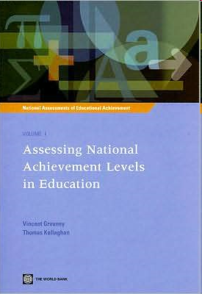

Slide 4


Slide 6


Slide 7
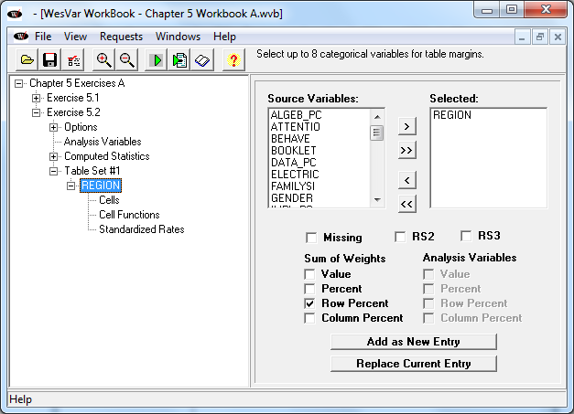

Slide 8
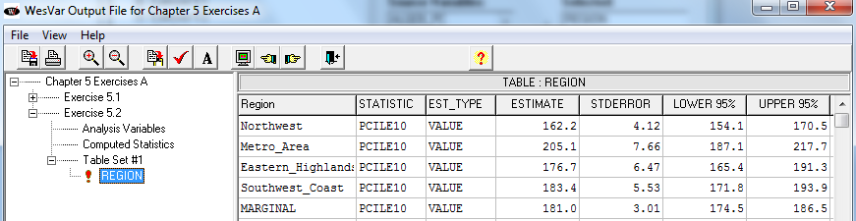

Slide 9
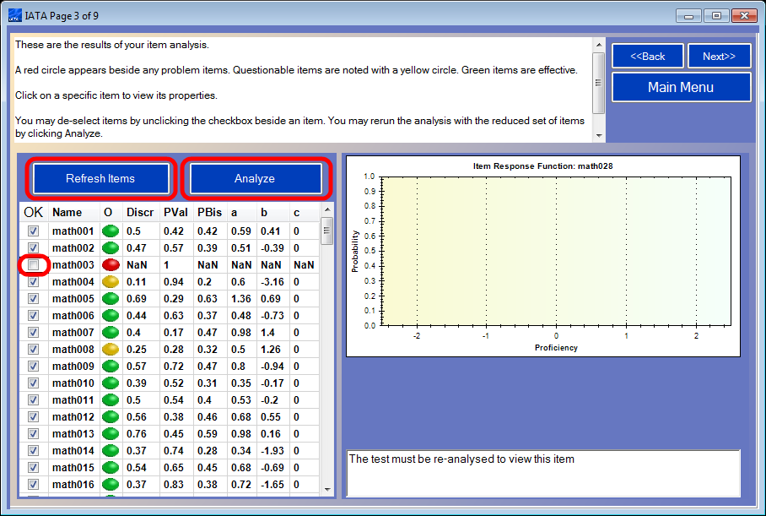

Slide 10


