Slide 1
Monitoring student achievement in Germany:
The role of national educational standards
in large-scale assessments
Dirk Richter
Eurasian Educational Dialogue, Jaroslawl
18.04.2013

Slide 2
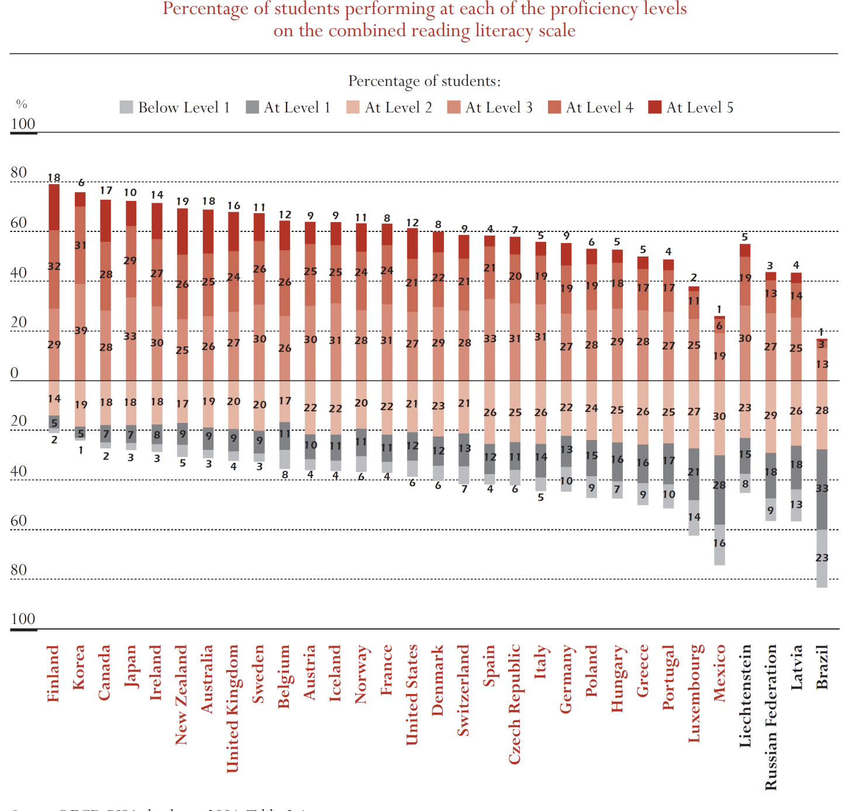
Empirical Shift in Response to the „PISA Shock“
PISA 2000: Percentage of students at each proficiency level on the reading scale
Need to improve academic performance of students across literacy domains
Need to diminish disparities for ethnic and social groups
Need to create a more flexible and open educational system

Slide 3
Shift from Input-based to Output-based Accountability
Intended
curriculum
Implemented (actual)
curriculum
Effective
curriculum
State-curricula
School books
Student
achievement
Instruction
Input
Process
Output (Outcome)

Slide 4
Actions to Improve the German Educational System
Establishment of national educational standards in primary and secondary education
National concept on educational monitoring
Foundation of the Institute for Educational Quality Improvement in Berlin

Slide 5
Actions to Improve the German Educational System
Establishment of national educational standards in primary and secondary education
National concept on educational monitoring
Foundation of the Institute for Educational Quality Improvement in Berlin

Slide 6
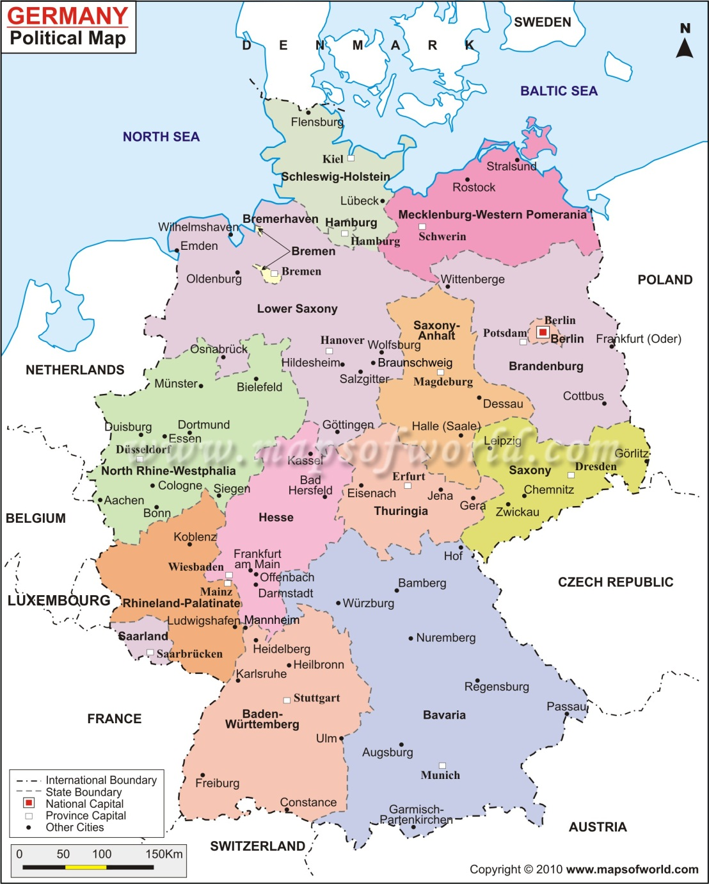
Educational Federalism in Germany
States determine….
the school curricula
the subjects and numbers of hours of each subject
duration of schooling (4 or 6 years in primary school)
number of school types
define school leaving exams
…

Slide 7

National Educational Standards in Germany
Enacted in 2003/ 2004 for core subjects (mathematics, German, first foreign language, science) by the Standing Conference of the Ministries of Education (KMK)
Standard do not replace but they supplement state curricula
Implementation is mandatory for all 16 states
Standardized assessment schemes at the end of primary and secondary school

Slide 8
National Educational Standards in Germany
describe the domain-specific competencies that should be acquired the end of
  primary school (grade 4),
  secondary school (grade 10)
  upper secondary school (grade 12)
specify competencies by can-do statements
represent the core elements of knowledge in the subject domains

Slide 9
Content Domains in Mathematics
Numbers and Operations
Space and Shape
Sizes and Measures
Pattern and Structures
Data, Frequency and Probability
Notes:
Numbers and operations: Carry out arithmatic operations
Space and shape: Operate with heometric figures
Pattern and structures: Describe regularities and fuctional relations,
Size and measures: Learn to deal with different measures such as length, time, currency, weight

Slide 10



Educational Standards in Mathematics :
Domain Numbers and Operations
Grade 4:
  Students undertstand the system of decimal numbers.
  Students can represent numbers up to 1.000.000 and put them into relations to each other.
  Stundents understand the four basic arithmetic operations and their interrelations.
Grade 10:
  Students represent numbers according to the situation, i.e. as decimal power.
  Students round results in contexts appropriately.
  Students apply caluclus of percentages and interest appropriately.

Slide 11
Actions to Improve the German Educational System
Establishment of national educational standards in primary and secondary education
National concept on educational monitoring
Foundation of the Institute for Educational Quality Improvement in Berlin

Slide 12
National Concept on Educational Monitoring
Continued participation in international student achievement tests (PISA, PIRLS, TIMSS)
National sample-based assessment of educational standards in all 16 federal states
  2011: German and mathematics (primary school)
  2012: Mathematics and science (secondary school)
  2015: German and First foreign language (secondary school)
National state-wide test of all students in grade 3 (German and mathematics) and 8 (German, mathematics, English/French)
National report on education (biannually)
Notes:
In the same year as international assessment in order to be able to link both studies with each other.

Slide 13
Comparison of Student Achievement Tests in Germany
 | International student achievement test (PISA, PIRLS, TIMSS) | National sample based assessment | Yearly state-wide test
Frequency | 3 / 5 years | 3 / 5 years | every year
Main Purpose
Who is accountable? ("High Stakes")

Slide 14
Comparison of Student Achievement Tests in Germany
 | International student achievement test (PISA, PIRLS, TIMSS) | National sample based assessment | Yearly state-wide test
Frequency | 3 / 5 years | 3 / 5 years | every year
Main Purpose | System monitoring | System monitoring | Formative Feedback
Who is accountable? ("High Stakes")

Slide 15
Comparison of Student Achievement Tests in Germany
 | International student achievement test (PISA, PIRLS, TIMSS) | National sample based assessment | Yearly state-wide test
Frequency | 3 / 5 years | 3 / 5 years | every year
Main Purpose | System monitoring | System monitoring | Formative Feedback
Who is accountable? ("High Stakes") | Federal Ministry of Education; 16 State Ministries of Education | 16 State Ministries of Education and their school authorities | Principals, teachers

Slide 16

Sample-based State Comparison Tests
Reports on the average achievement in core subjects in each state
Informs the 16 education ministers about strengths and weaknesses in their systems
Test cannot identify the causes for the results
Test of primary school students in 2011 in reading, listening and mathematics
27000 students of 1350 schools were involved
80-120 schools in each state

Slide 17
Major Findings of the 2011 State Comparison Test
About 66% of the students master the educational standards in reading, 74% in listening and 68% in mathematics
Students in Baviaria, Saxony, Saxony-Anhalt and Thuringia reach levels above average in reading
Strong interrelation between SES of parents and the competence of the children – but it differs between federal states
Children with migration background perform much more poorly than children without migration background
Students whose teachers studied mathematics performed better than students whose teachers did not study the subject
Notes:
There are always good news and bad news…

Slide 18
Results in Reading for Bavaria and Berlin
Percentages

Slide 19
State Comparison Test 2011 in Grade 4:
Results in Reading
Notes:
Tabelle und Graphik selbst etwas größer formatieren! (erledigt)
Fußnote muss bleiben, aber es kann gelöscht werden:
Anmerkung
Legende Perzentile
Spalten (SE)
Werte für 10., 25., 75., 90. Perzentil
Und Erläuterung der Kästen kann kleiner.

Slide 20


Consequences of the State Comparison Test 2011
Standing Conference of the 16 ministers of education agreed to
  Reduce the proportion of low-achieving
  students and increase the number of
  high-achievers.
  Evaluate the programs for language and
  reading literacy and continue their
  improvement.
  The states increase their efforts in teacher education and professional development of teachers.
Notes:
3. in the domain of individualized indstruction and inclusion of students with special

Slide 21
Actions to Improve the German Educational System
Establishment of national educational standards in primary and secondary education
National concept on educational monitoring
Foundation of the Institute for Educational Quality Improvement in Berlin

Slide 22
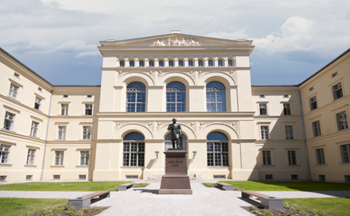
The Institute of Educational Quality Improvement (IQB)
National institute funded by the 16 federal states
Housed at Humboldt University Berlin
Responsibilities
  Develop and revise national standards
  Develop test instruments to assess national standards
  Support implemention process
  National reporting on comparison tests
  Establish a data warehouse for
  secondary data analysis
Notes:
Founded in 2004

Slide 23
Challenges of National Testing in Germany
Student achievement tests have been implemented in a short time period
teachers were not sufficiently trained to make use of the test data
teachers hardly use the test data for instuctional decisions
Test results have no consequences for schools or teachers (low stake tests)
Tests measure cross-sectionally in selected grade levels
⇨ They do not provide information about students‘ development
Notes:
regularly get feedback on their students‘ performance but they

Slide 24



Thank you for your atten n
Dr. Dirk Richter
E-Mail: dirk.richter@iqb.hu-berlin.de
Notes:
24

